Slide 1
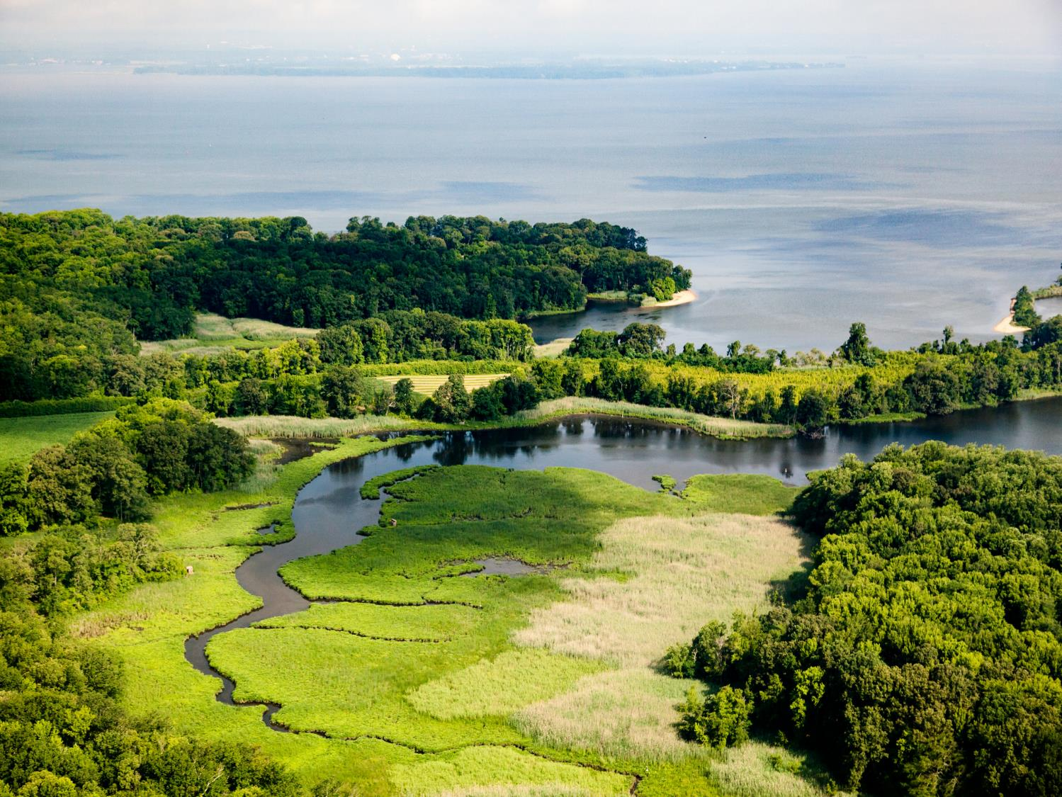


Slide 2
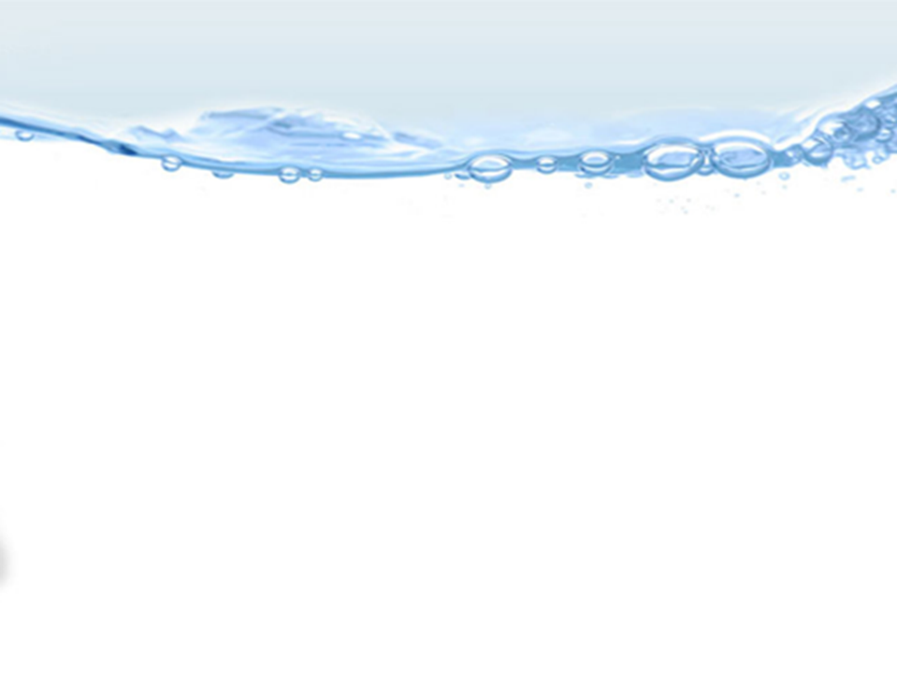
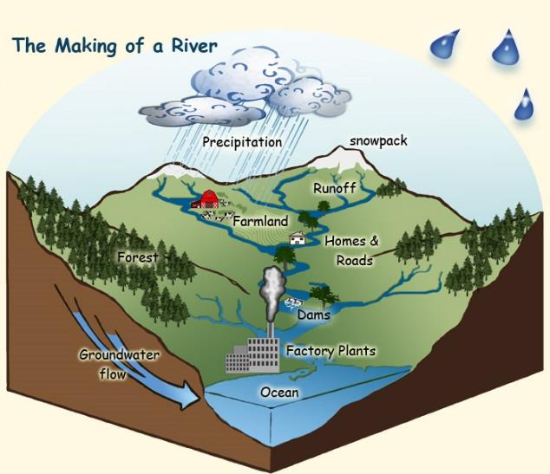


What is a Watershed?
A watershed is an area of land that channels rainfall and snowmelt to creeks, streams, and rivers, eventually leading to outflow points such as reservoirs, bays, and the ocean. Those bodies of water are all connected, so every drop that falls becomes part of one water.
Notes:
A watershed is land that sheds water. Water from rain or snow can flow over the land it falls on. The water can flow to a river, lake, stream or ocean. All of the water under or draining off of a particular watershed goes into the same place. Watersheds come in all shapes and sizes. They cross county, state and national boundaries. Some are millions of square miles, others are just a few acres. Homes, farms, ranches, forests, small towns, big cities and more can make up watersheds. You're sitting in a watershed now.

Slide 3
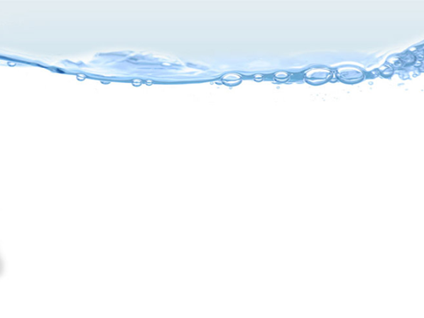
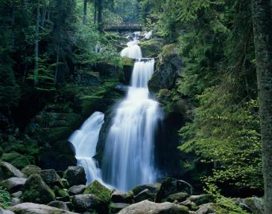
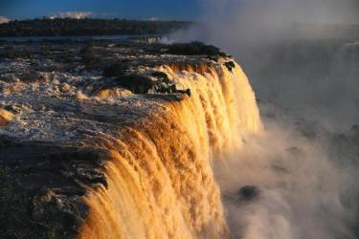
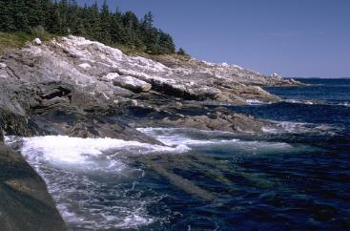

How does Water flow in a Watershed?
Watersheds can be any size and usually have some high points of land like hills, mountains, or ridges. When rain, sleet, or snow falls to the ground, the precipitation runs from those higher points to the lower points. Gravity pulls the water downhill until it reaches a body of water. If the land in the watershed is steep, the water usually runs off into rivers or streams. If the land in the watershed is level, the water will slowly flow into lakes or ponds, or seep into the soil and add to groundwater. If the watershed is close to the ocean, then tidal marshes, estuaries, and wetlands will be part of the watershed. From the top of the mountain all the way to the coast, it is all one water.
Notes:
Gravity helps the rain, sleet, and snow flow from the ground to join the rest of the water in the oceans, lakes, rivers, streams, or ponds.

Slide 4
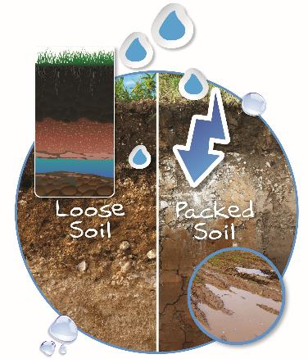
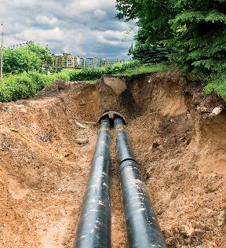
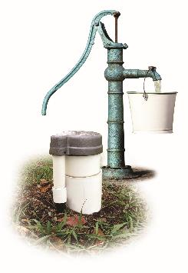
Flowing through the Watershed
Notes:
Water can also soak into the soil until it reaches underground rivers or aquifers. Some rain, sleet, and snow soak into the ground where it is stored as ground water. Groundwater is water that moves through spaces in soil and rock underground.

Slide 5

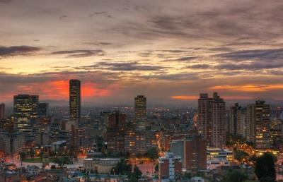
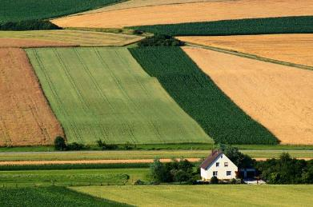
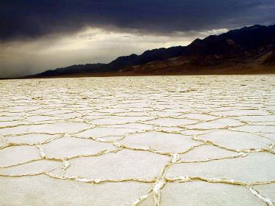
Not all Watersheds are Alike
Notes:
Watersheds can vary greatly in climate, animal life, plant life, human population, amounts of water, and size. Even the desert known as Death Valley is part of a watershed – the Bad Water Basin Watershed. Deserts typically receive ten inches or less of precipitation per year. The rain usually comes in brief downpours resulting in flooding as the water flows across the dry, caked soil. Remember, not all water in a watershed is above ground. Even in the desert, there are underground rivers and aquifers where water flows.

Slide 6

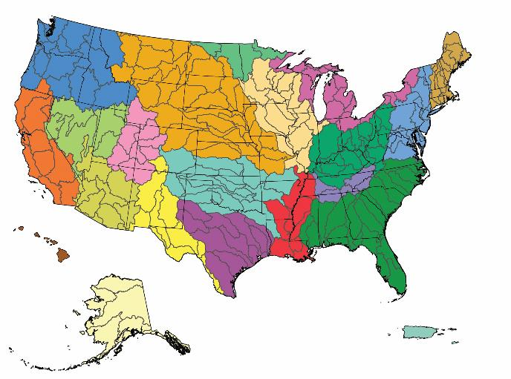
Where is the Watershed?
Notes:
Everywhere! Remember, every piece of land on the planet is part of a watershed. In the continental US, there are 2,100 watersheds. If Hawaii, Alaska, and Puerto Rico are included, the count rises to 2,267 watersheds.

Slide 7
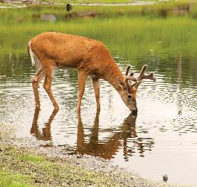
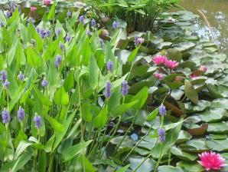
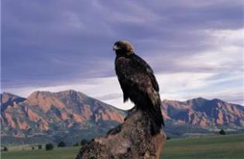
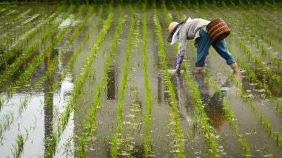
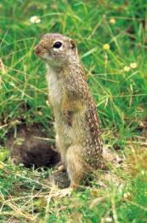
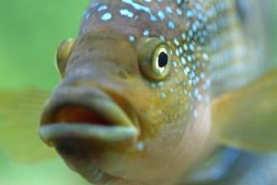
Who Lives in the Watersheds?
Notes:
You and everyone you know lives in a watershed. We share the water in our watershed with other people, with animals and with plants. We all live in the watershed.

Slide 8
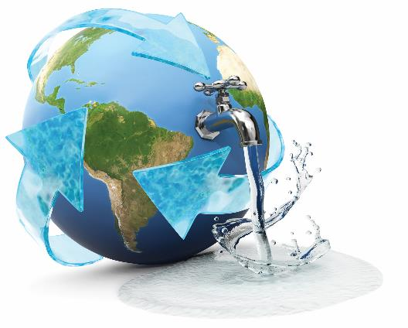
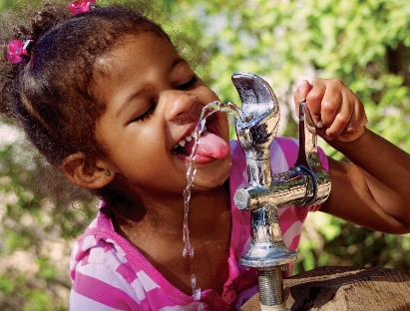
Drinking Shed Water
Have you ever watched it rain? The raindrops fall on the ground and flow through the soil. Water soaks through the soil until it reaches groundwater, which is water that moves through spaces in soil and rock underground. A lot of the water we use and drink every day comes from water in the ground. As it rains and the water runs off, it collects in rivers, lakes, and oceans and then returns to the atmosphere to fall as rain somewhere else. All land across the entire earth is made up of watersheds. We all live in a watershed. We share the water in our watershed with other people, with animals, and with plants because… it is all one water.
Notes:
Some of the water you drink comes from your watershed! Water from the watershed drains into lakes, rivers, and streams or through the soil into ground water. The world’s fresh water supply is not new. Our water is being constantly recycled through the earth’s water cycle. A drink of water, whether from a fountain, faucet, or bottle, could be thousands of years old and may have travelled around the world a few times.

Slide 9
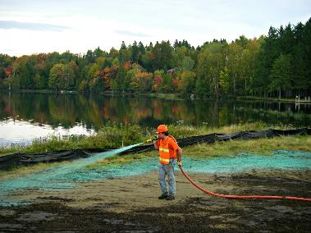
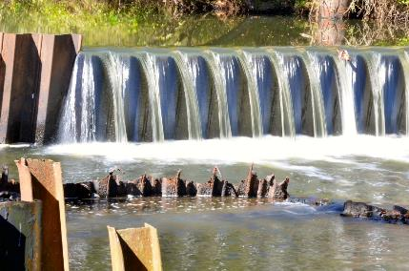
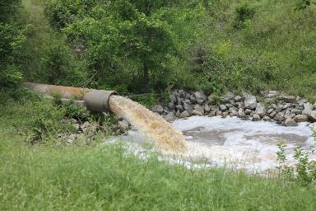
Watershed Conservation
Notes:
We all need to work hard to keep our watershed clean. It is important to take good care of our watershed so that we have fresh, clean water. Only 1% of the water on our planet is fresh useable water. The average person uses 70 gallons of water every day! Tell your family and friends how important it is to practice good conservation habits in your watershed.

Slide 10
2023
POSTER CONTEST

Slide 11
Poster Contest Details
The national winning poster will be used for local and state level promotion materials.
Send entries to your local conservation district
ashtabulaswcd@gmail.com
Local contest deadline is May 22,2023!!!!
Contest Categories
  K-1st Grade
  2nd-3rd Grade
  4th-6th Grade
  7th-9th Grade
  10th-12th Grade

Slide 12
Poster Contest Details
Winning entries will be selected by your local district and sent to the state level for judging.
State winner entries will then be sent to the national level, where one overall winner will be selected and announced at the 2024 NACD Annual. Winners will also be posted to the NACD website.
Monetary prizes will be awarded to the 1st - 3rd place winners in each category at the national level.
  $200 for 1st Place Winners
  $150 for 2nd Place Winners
  $100 for 3rd Place Winners

Slide 13
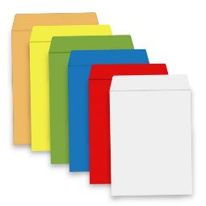
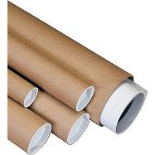
Poster Contest Details
Turn poster in on time for judging. Your local conservation district’s entry deadline is May 22,2023
Attach poster entry form on the back of each poster and be sure it is signed by a parent or guardian.
Entry must be contestant's original creation and may not be traced from photographs or other artists' published works.

Slide 14
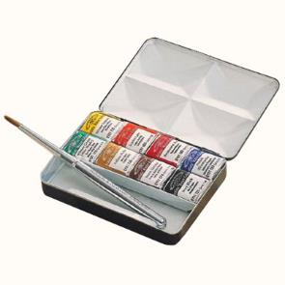
Poster Contest Details
Any media may be used to create a flat poster
  Paint
  Crayons
  Colored pencil
  Charcoal
  Stickers
  Paper
  Or other materials
Poster size must be 11" x 17" (half a poster).

Slide 15
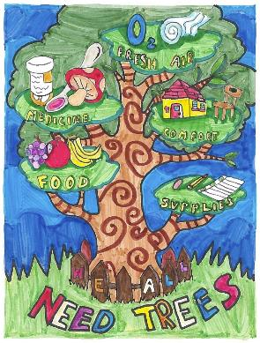
What makes a good Poster?
Attracts attention
Is simple and concise
Uses colors and white space effectively
Text is large enough to be easily read

Slide 16
Brainstorming Poster Ideas
Research the topic of the theme
Brainstorm ideas and make a list
Use the theme as your title: Watersheds – One Water
Use some of the important water issues from this presentation.
Look around your community for ideas.
Talk to professionals in the industry.
Research watersheds online and use the information found in your poster.

Slide 17
Do:
  Do limit text, and balance a combination of illustrations and words.
  Do be as neat as you can and be sure to erase any penciled sketches or guidelines.
  Do blend colors when using crayons or colored pencils.
  Do research the theme topic as a way to brainstorm poster ideas.

Slide 18
Don’t:
  Don’t use staples, tacks, or tape.
  Don’t use fluorescent-colored posters.
  Don’t create a poster that is all words or all illustrations.
  Don’t have your parent or others draw your poster for you to color in.
  Don’t try to include too many ideas. A single message – clearly illustrated – is most effective.

Slide 19
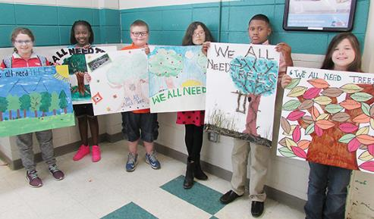
Judging Criteria
Conservation message - 50 percent
Visual effectiveness - 30 percent
Originality - 10 percent and
Universal appeal - 10 percent

Slide 20
For Additional NACD Information
Visit http://www.nacdnet.org/general-resources/stewardship-program/
Entry Forms, Rules, and Resource PDF files are also available for download on the contest page.
http://www.nacdnet.org/education/contests

